Slide 1
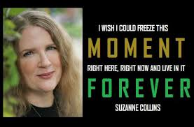
By: Mr. Kreuser

Slide 2
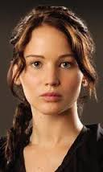
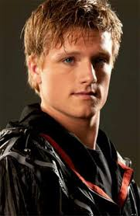
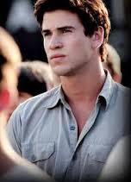
Who, What, When, and Where
Major characters include Katniss Everdeen, Peeta Mellark, Gale Hawthorne, and Catniss’s sister and mother.
Katniss = main character, protagonist, and very dynamic!
Major Conflict= Katniss chooses to volunteer for his sister’s spot in the Hunger Games.
Science Fiction= the book is in the future. The government is corrupt and has divided the country into 13 different “districts.”
District 12= Katniss lives here. It’s a rough and tough place full of coal miners!

Slide 3
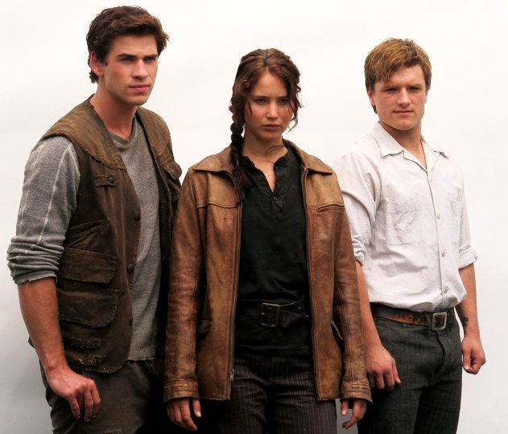
Conflicts and Resolutions
Catniss is in the Hunger Games vs. 23 other tributes, 2 from each district. It is a survival of the fittest (Character vs. Character).
Katniss learns that Peeta loves her, but Katniss is in love with someone else. Does she tell him and the rest of the world? (Character vs. Self)
The government is in control of the games and Katniss is afraid to break the rules. If she doesn’t play their game, will she survive? (Character vs. Society).

Slide 4
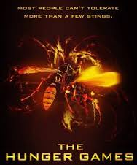
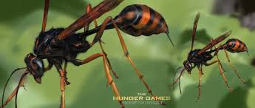
Some of my Favorite Highlights
The fighting scenes were amazing! This book isn’t for people who get grossed out by blood and gore.
Every chapter ends with a twist! There is a lot of foreshadowing.
Surprises that you never see coming: the tracker jackers

Slide 5
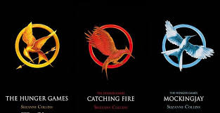
Rating, Reviews, Etc.
I rated this book a 5 out of 5 stars!
It had non-stop action.
It made me want to keep reading.
I’ve read the book more than once, and seen the movie.
It made me want to read more science fiction, even though I never was a fan!

Slide 6
Action-Packed Romantic Mysterious Unpredictable VIolent SuRVIVAl
Read The Hunger Games by Suzanne Collins

